Slide 1
INTRO TO REACT
https://github.com/tnt-summer-academy/Curriculum-2022/wiki

Slide 2
Wiki https://github.com/tnt-summer-academy/Curriculum-2022/wiki
Exercises https://github.com/tnt-summer-academy/Exercises
Samples https://github.com/tnt-summer-academy/Samples

Slide 3
Learning Objectives
TNTs will know what React is
TNTs will understand how React fits into the app architecture
TNTs will learn the basic pieces of the project generated by the React tool chain
TNTs will be able to edit and run an app
TNTs will learn about components
TNTs will be able to build on the generated code to build some new app

Slide 4
PART 0 IMPORTANT RESOURCES & COMMANDS

Slide 5
Resources
Official React web site
https://reactjs.org/
w3cschools
https://www.w3schools.com/react/default.asp

Slide 6
Important commands
Installation
sudo npm install -g create-react-app
Creation of an app with React
create-react-app my-app
Running a React app
npm start
From the correct directory!
Installing a React app
npm install
From the correct directory!

Slide 7
PART 1 WHAT IS REACT?
20 minutes

Slide 8
What is React?
React is an open source JavaScript library developed by Facebook for building user interfaces.
Used and contributed by Microsoft in web experiences across teams, Netflix, New York Times, Khan Academy, Dropbox...
UI is built in small, isolated pieces called components
Components have optional input and tell React what to display on the screen
When the data changes, React reacts and updates the screen
CSS is used to style React
React is the code behind rendering HTML in a webpage

Slide 9
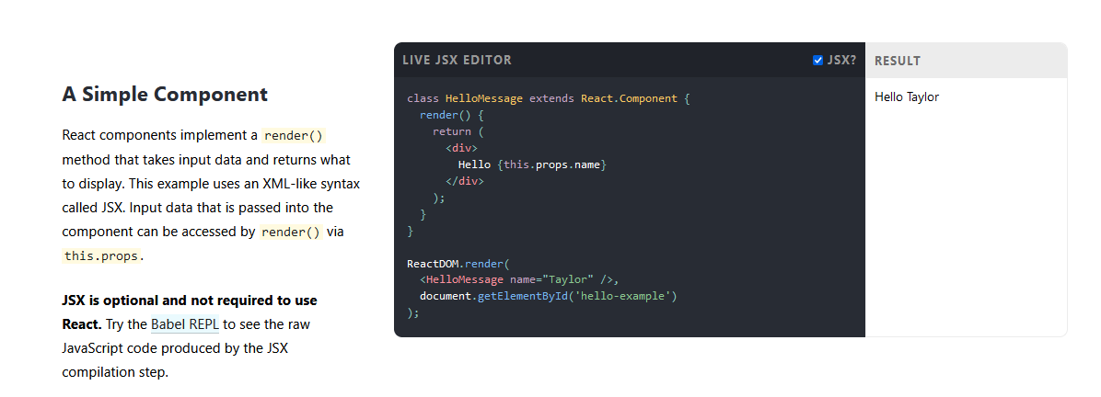
Tour of https://reactjs.org/

Slide 10
Principles
Declarative – Design views for each state of the application. React will render and update the right components based on the changed data
Components based – Build encapsulated components that manage their state and compose them to produce new ones. Components are reusable. Data can be passed through components using props (proprieties) (avoiding DOM)
Learn once, write anywhere – Also render on the server side using Node and on mobile apps using React Native

Slide 11
Toolchain
React App to create a single-page app (Babel JavaScript compiler and webpack module bundler)
Next.js to create a server-rendered website with Node.js
Gatsby to create a static content-oriented website

Slide 12

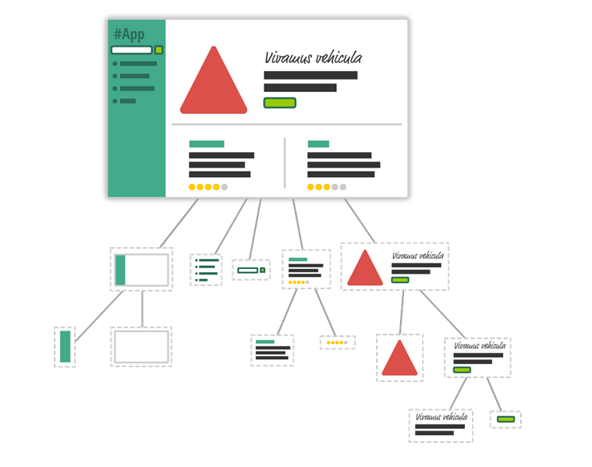
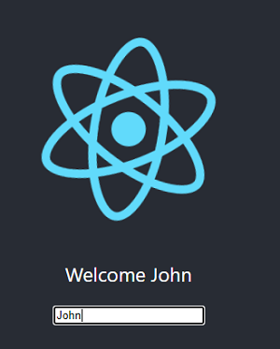
Components
Component with an image, text and an input box
https://www.kirupa.com/react

Slide 13
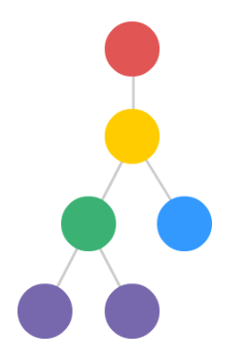
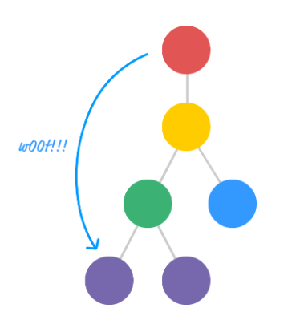
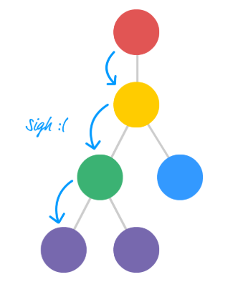
Props
<App name = ”John" city=”NYC">
https://www.kirupa.com

Slide 14
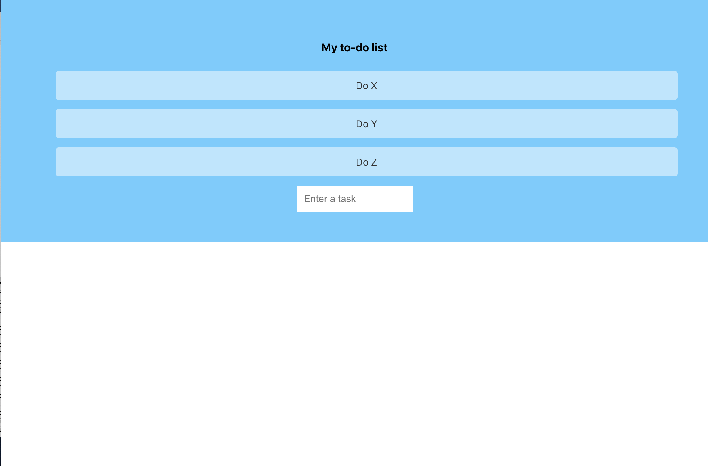
State – it’s changing!
name
List of tasks

Slide 15

Component in React
Class & Function Components
https://reactjs.org/

Slide 16
PART 2 CREATE-REACT APP
20 minutes

Slide 17
Important commands
Installation
sudo npm install -g create-react-app
Creation of an app with React
create-react-app my-app
Running a React app
npm start
From the correct directory!
Installing a React app
npm install
From the correct directory!

Slide 18
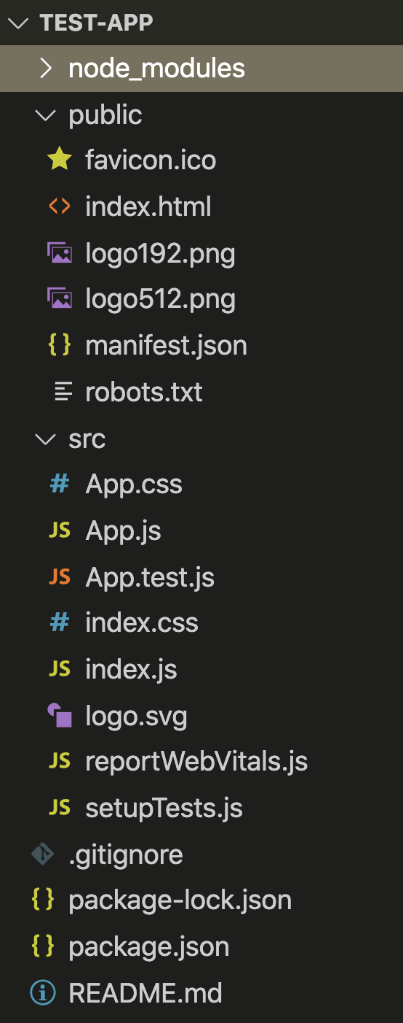
Tour of the files

Slide 19
LET’S LOOK AT THE APP, RUN IT, MAKE A CHANGE IN THE CODE, AND OBSERVE

Slide 20
Overview of the main files
index.html - root is the id of the div element and is used in other files
index.js
Notice the import (and the other import)
import App from './App';
The function render permits to render the App component into the root DOM
App.js
Defines the component App as àa function
Look at the imports
A function called App is created. App is a React component. It returns a JSX <div> element
JSX is JavaScript + XML

Slide 21
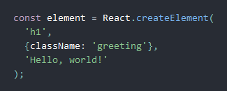
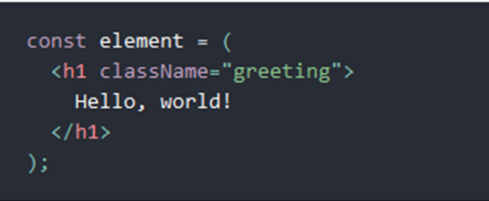
JSX
JSX = JavaScript + XML
JSX gets compiled to React.createElement() calls which return plain JavaScript objects called “React elements”
React DOM uses camelCase property naming convention
NO JSX
JSX

Slide 22
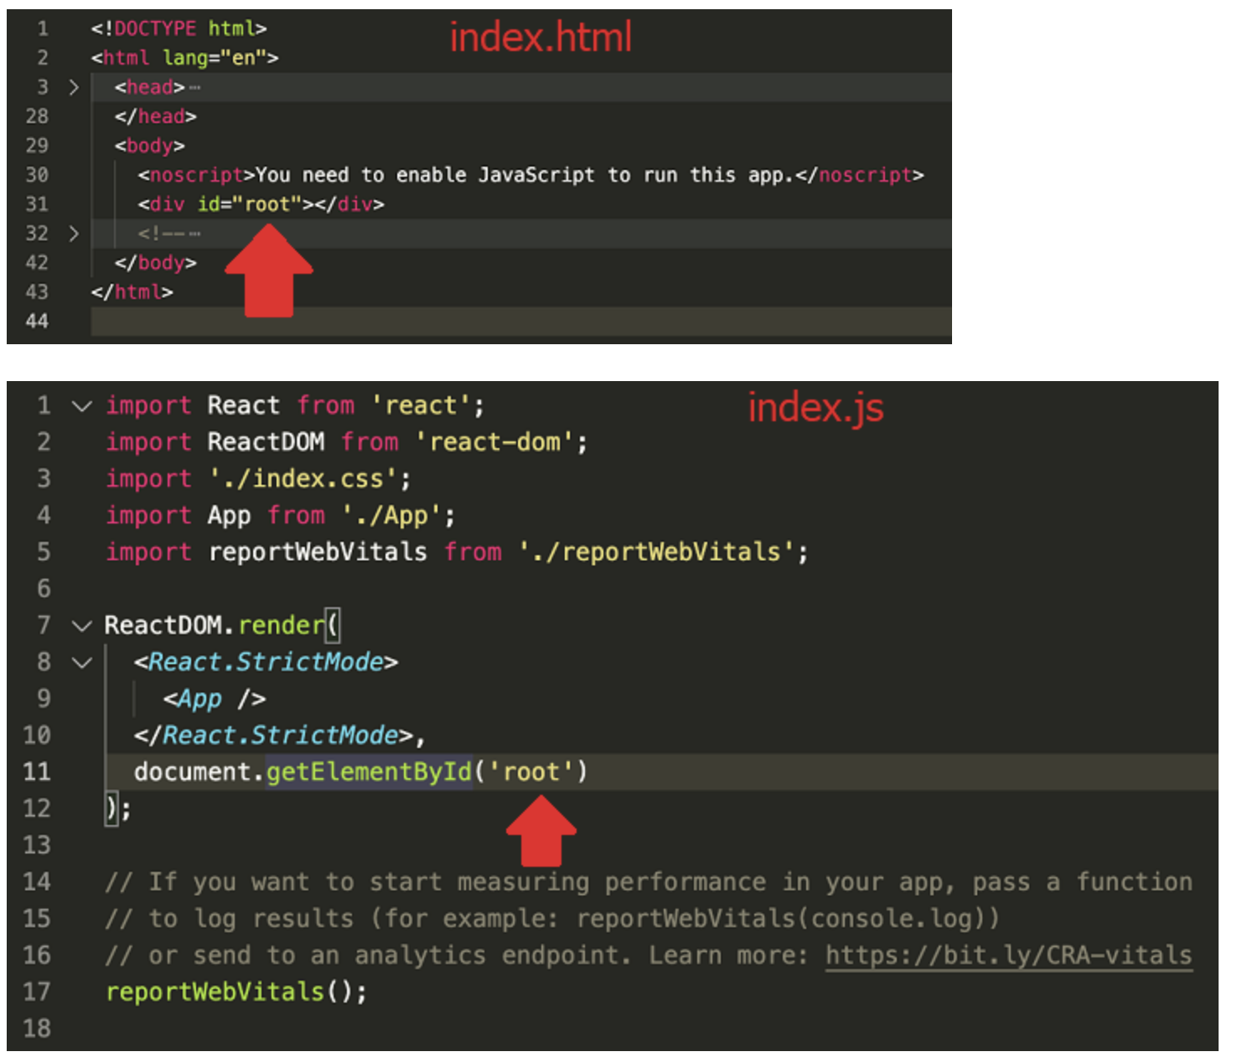
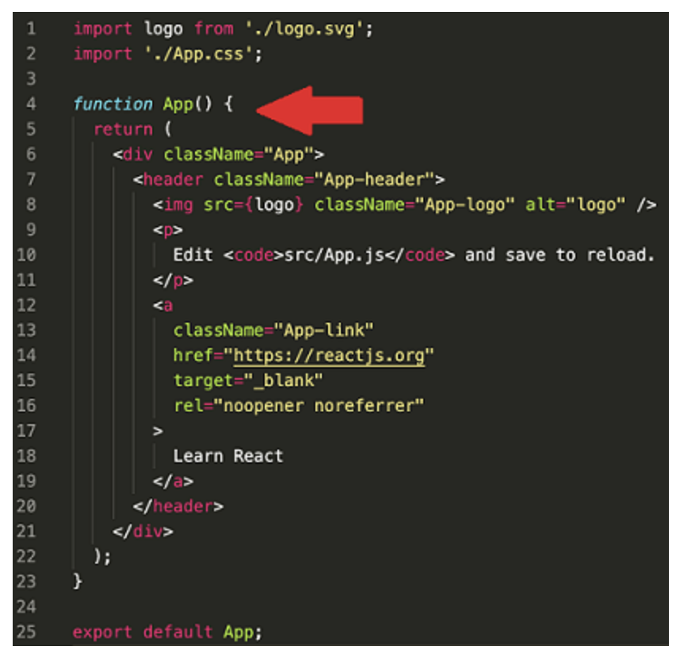

Slide 23
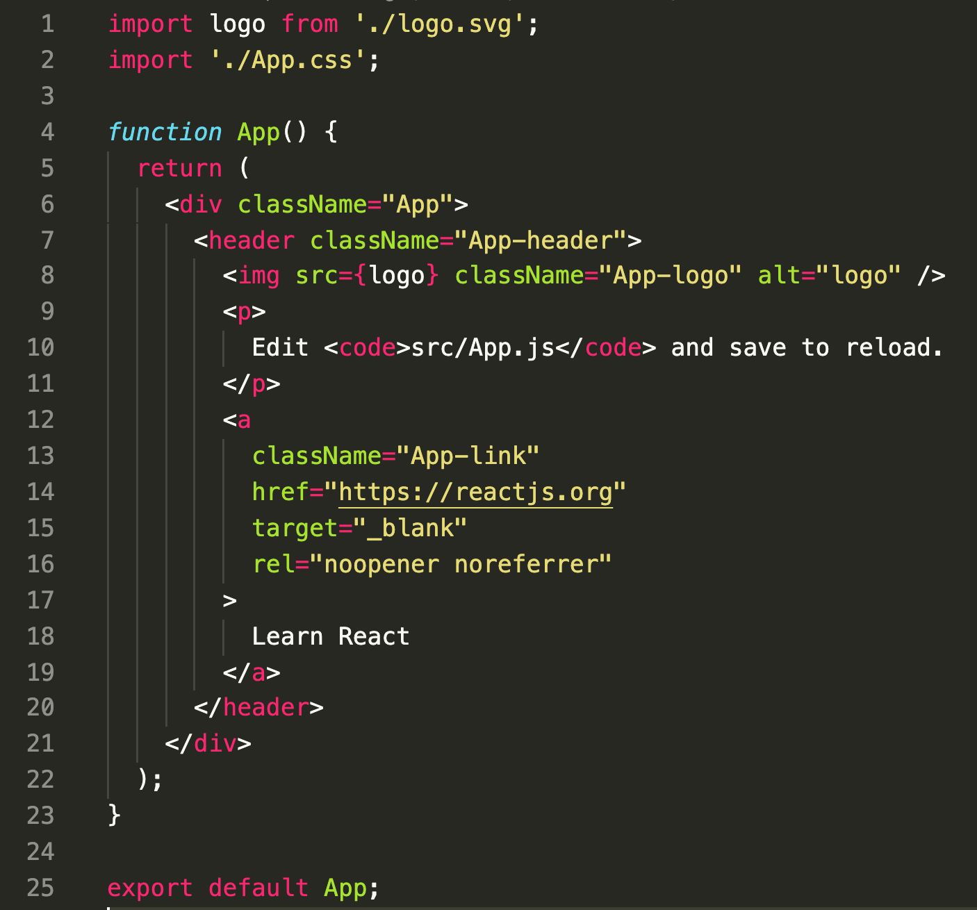

Slide 24
PART 3 APP ARCHITECTURE
15 minutes

Slide 25
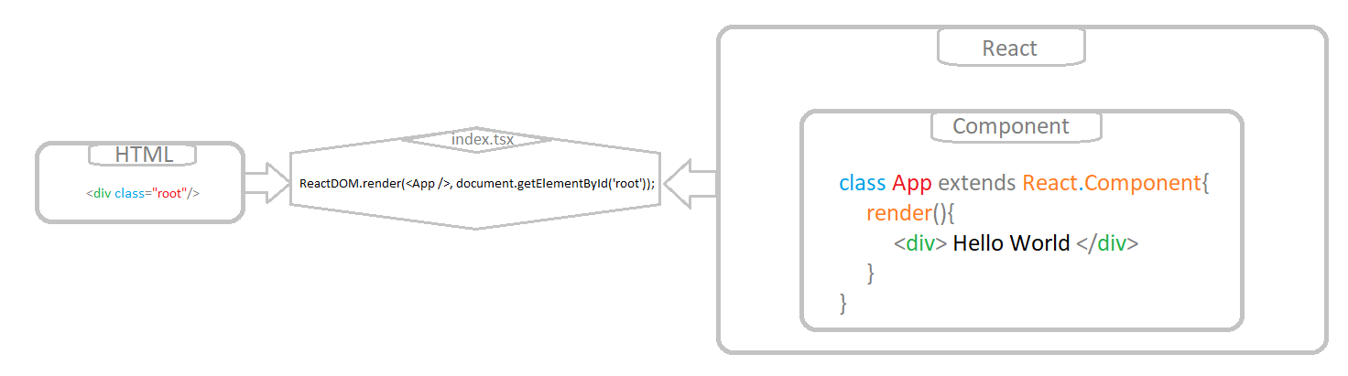
App.js
index.html
index.js

Slide 26
PART 4 LIVE CODING - house example
15 minutes

Slide 27
PART 5 LIVE CODING - input-app-javascript
25 minutes

Slide 28
INPUT-APP-JAVASCRIPT
https://github.com/tnt-summer-academy/Samples/tree/main/Week_1/input-app-javascript
Updates a welcome string based on input text

Slide 29
Open input-app-javascript in VS Code
npm install
npm start

Slide 30
Things to review
React.Component
state= {name: ""}
<input type="..." value={...} onChange={...}/>
onChange = (e) => { this.setState({ name: e.currentTarget.value });};

Slide 31
Things to review
class App extends React.Component{
constructor(state: MyState) {
super(state);
this.state = { name: "" }
}
…
}

Slide 32
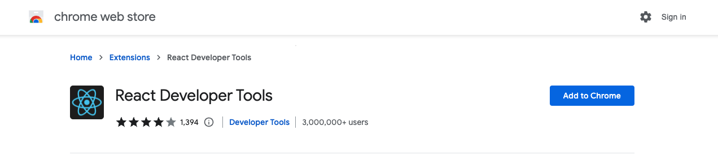

Slide 33
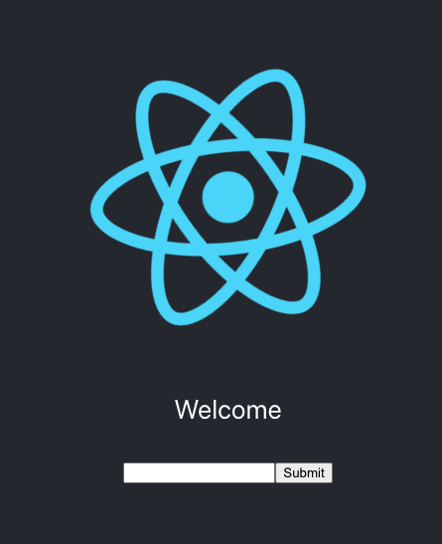
STRETCH
Refactor the input-app-javascript to obtain a functional component
Use a button in input-app-javascript
Get help and hints here https://www.w3schools.com/react/showreact.asp?filename=demo2_react_forms

